Slide 1

Insights for "Social Buzz"
Accenture – Navigating Numbers

Slide 2

Today's agenda
Project recap
Problem
The Analytics team
Process
Insights
Summary

Slide 3

Social Buzz is a fast-growing Social Media conglomerate that is looking for help to oversee their scaling process effectively, to allow it to compete on a global scale.
Accenture has started a 3 month POC focusing in:
An audit of Social Buzz's big data practice.
Recommendations for a successful IPO
Analysis to find Social Buzz's top 5 content categories.
Project Recap

Slide 4


Problem
The platform generates more than 100,000 post per day, and over 36,500,000 pieces of content a year.
All this content can give valuable insight about the behavior of the users.
Starting by discovering which are the top 5 most popular content categories by their score.

Slide 5



Andrew Fleming
Chief Technology Architect
The Analytics team
Marcus Roptom
Senior Principal
Eduardo Romero
Data Analyst

Slide 6

Process
1
Gather and select the required Datasets
2
Clean the data in Excel
3
Data modeling – Merge the useful data into one table
4
Analize the data – Go through an Exploratory Data Analysis
5
Gather Insights – Create Visualizations to show them

Slide 7

Insights
The most popular Content categories were:
Animals
Science
Healthy Eating
Technology
Food
962 different pieces of content were analyzed through 16 different categories.
Over 56% of the reactions to the content were positive.

Slide 8
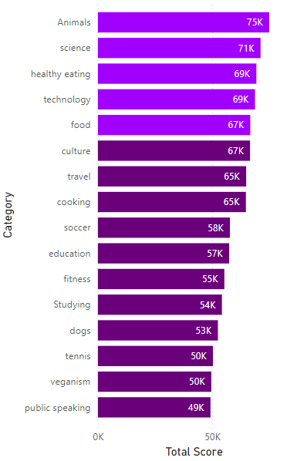
Business question:
Which were the 5 top performing content categories?
The top 5 Content Categories were:
Animals
Science
Healthy Eating
Technology
Food
More insights:
There are other 3 Content Categories that are close to the Top 5, which are:
Culture
Travel
Food

Slide 9
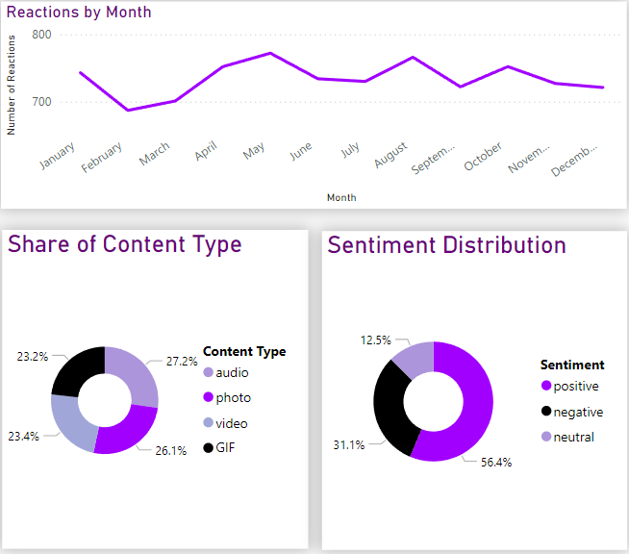
Metrics of the Top 5 Content categories
The content type most used was Audio (27.2%), followed by Photo (26.1%), Video (23.4%) and at last, GIF (23.2%). Meaning that there is not major preferences over certain Content Types.
The majority of reactions to the content was Positive (56.4%), with almost a third being Negative (31.1%), and an eighth being Neutral (12.5%).
The Month with most activity was May, with 772 reactions.

Slide 10
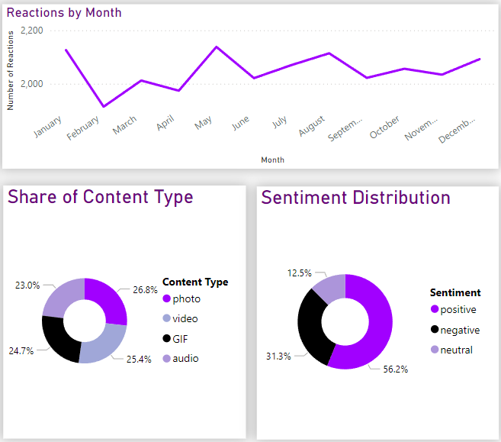
Metrics of the all Content categories
The content type most used was Photo (26.8%), followed by Video (25.4%), GIF (24.7%) and at last, Audio (23%). The preferences for different Content Type are distributed almost even on a general view.
The majority of reactions to the content was Positive (56.2%), with almost a third being Negative (31.3%), and an eighth being Neutral (12.5%).
The Month with most activity was May, with 2138 reactions.

Slide 11

In conclusion.
There are 3 other content categories that are close to the top 5, being: Culture, Travel, and Cooking. Which deserve a further look.
The major part of the reactions in the platform are positive in all content categories. However, there is a considerable portion of negative reactions as well, becoming almost a third of all reactions in the platform.
The behavior of the Top 5 Categories and the All Categories is consistent, both in Sentiment as in Type of Content. Meaning that the content posted overall is consistent through all the platform.
Summary

Slide 12
Thank you!

